Slide 1
BCA Mini Project (Review I)
RAPIDAID — A Multilingual, AI-Powered, Confidence-Adaptive Emergency First-Response Guidance System
Submitted to the Presidency University, Bengaluru in partial fulfillment for the award of the degree of Bachelor of Computer Applications(BCA)
Project Number :
Under the supervision of
Ms Aswathy N Rajan
Assistant Professor, BCA
Presidency School of Information Science
Name | Roll Number
Shravya S | 20241BCA0077
Swathi | 20241BCA0148
Shriya M | 20241BCA0042
Sinchana | 20241BCA0025

Slide 2
Content
Problem Statement
Literature Survey
Tools and Technologies to be used
Timeline of the Project
Github Link
References

Slide 3
Problem Statement
During emergencies, bystanders may hesitate to provide immediate first-response assistance due to panic, lack of first-aid knowledge, language barriers, and uncertainty about what to do.
In situations such as unresponsiveness, abnormal or absent breathing, choking, severe bleeding, sudden falls, and serious injuries, immediate and appropriate action can be extremely important. RapidAid aims to assist bystanders during the critical period before professional medical assistance arrives.
Existing solutions may provide general first-aid information without adapting guidance to the user's emergency, confidence level, or preferred language. RapidAid addresses this gap through interactive, multilingual, AI-assisted, and confidence-adaptive first-response guidance.

Slide 4
SAMPLE LITERATURE REVIEW
S.NO | TITLE | FINDINGS | YEAR
01 | Evaluation of M-AID, a first aid application for mobile phones | Evaluated a mobile first-aid application that used intelligent yes/no questions to assess an emergency and provide detailed instructions. The study found that the app could support CPR performance, but it could not replace practical first-aid training. | 2007
02 | Cell Phone Cardiopulmonary Resuscitation: Audio Instructions When Needed by Lay Rescuers: A Randomized, Controlled Trial | Found that prerecorded CPR audio instructions improved compression rate, depth, hand placement, and reduced pauses compared with no phone assistance. This supports RapidAid's use of voice-based, step-by-step emergency guidance. | 2010
03 | Medical Correctness and User Friendliness of Available Apps for Cardiopulmonary Resuscitation | Reviewed CPR apps and found that only a small proportion fulfilled all selected guideline-adherence criteria, highlighting the need for medically reviewed and user-friendly emergency guidance. | 2018
04 | Interventions to Improve the Quality of Bystander Cardiopulmonary Resuscitation: A Systematic Review | Reviewed interventions such as dispatcher-assisted CPR, real-time feedback, and mobile CPR applications, supporting the use of simplified instructions and technology-assisted guidance. | 2019
05 | Designing an App to Overcome Language Barriers in the Delivery of Emergency Medical Services: Participatory Development Process | Developed a smartphone-based app to support communication between paramedics and patients who speak different languages, demonstrating the importance of language selection and understandable emergency communication. | 2021

Slide 5
SAMPLE LITERATURE REVIEW
S.NO | TITLE | FINDINGS | YEAR
06 | Can a Voice Assistant Help Bystanders Save Lives? A Feasibility Pilot Study Chatbot in Beta Version to Assist OHCA Bystanders | A voice-based chatbot guided participants through cardiac-arrest recognition and CPR. The study found that 91% completed the sequence correctly, but further development was needed to improve response time and CPR feedback. | 2022
07 | Quality of Layperson CPR Instructions From Artificial Intelligence Voice Assistants | Evaluated AI voice assistants and found that many responses were unrelated to CPR or provided incomplete instructions. The study emphasized the need for evidence-based content and prioritizing emergency-service contact. | 2023
08 | Overcoming Language Barriers in Paramedic Care With an App Designed to Improve Communication With Foreign-Language Patients: Nonrandomized Controlled Pilot Study | Evaluated a multilingual emergency communication app supporting 18 languages, with text and audio playback. The study demonstrates how structured multilingual communication can support emergency care. | 2023
09 | Generative Artificial Intelligence as a Source of Advice on Resuscitation and First Aid for Laypeople: A Scoping Review | Reviewed 19 studies and found frequent problems with AI-generated first-aid advice, including incomplete and inaccurate instructions. The findings support using AI with structured, medically reviewed guidance. | 2026
10 | Development and Evaluation of Multi-Modal Universal CPR AI Assistance Response Engine (U-CARE) | Proposed a smartphone-based CPR assistance system combining adaptive AI verbal guidance, multiple languages, and computer vision for CPR feedback. It is closely related to RapidAid's proposed multimodal assistance approach. | 2026

Slide 6
Brief Overview of the Project’s Modular Architecture
RapidAid is divided into separate modules such as emergency assessment, decision-making, step-by-step guidance, voice assistance, multilingual support, confidence adaptation, and location assistance. These modules work together to provide personalized first-response guidance during emergencies.
Purpose of Dividing the Project into Modules
To divide the project into smaller and manageable parts.
To make development and testing easier.
To allow each module to perform a specific function.
To improve system maintenance and future updates.
To make it easier to add new emergency scenarios, languages, and features.
To improve reliability by reducing errors in individual components.

Slide 7
Module Design
MODULE | FUNCTION
Emergency Assessment Module | Identifies the emergency through simple questions about the victim’s condition.
Rule-Based Decision Engine | Selects the appropriate first-aid procedure using predefined medically reviewed pathways.
Step-by-Step Guidance Module | Provides clear instructions using text, images, animations, and highlighted action areas.
Voice Assistance Module | Supports speech-to-text and text-to-speech for hands-free guidance.
Multilingual Module | Provides instructions in English, Kannada, Hindi, Telugu, Tamil, and Malayalam.
Confidence-Adaptive Module | Changes the level of explanation based on the user’s confidence and ability to act.
Location Assistance Module | Displays emergency contacts, nearby hospitals, navigation, and location-sharing options.
Emergency Session Module | Maintains the current emergency session and supports pause, resume, and repeat instructions.

Slide 8
Tools And Technologies To Be Used
Development Tools
Visual Studio Code – For writing and managing code.
Figma – For designing the user interface.
GitHub – For version control and project collaboration.
Programming Languages
Dart – For Flutter application development.
Python – For backend, AI, and decision-making logic.
Frameworks and Libraries
Flutter – For developing the mobile application.
FastAPI – For creating the backend API.
OpenCV / MediaPipe – For optional camera-based assistance.
TensorFlow – For optional AI-based detection.
Database and Services
Firebase / PostgreSQL – For storing user and emergency session data.
Firebase Authentication – For secure user login.
GPS and Maps API – For location and nearby hospital assistance.
STT/TTS APIs – For voice input and audio instructions.
Additional Hardware
ESP32 – For optional fall-detection sensors using an accelerometer and gyroscope.

Slide 9
Github Link
GitHub Repository: RapidAid
Purpose: To store and showcase the project documentation, source code, designs, and future updates.
Repository Link: shravyasowmya29-bot/RapidAid: RapidAid is a multilingual, AI-powered, confidence-adaptive emergency first-response guidance system.
Access: Public

Slide 10
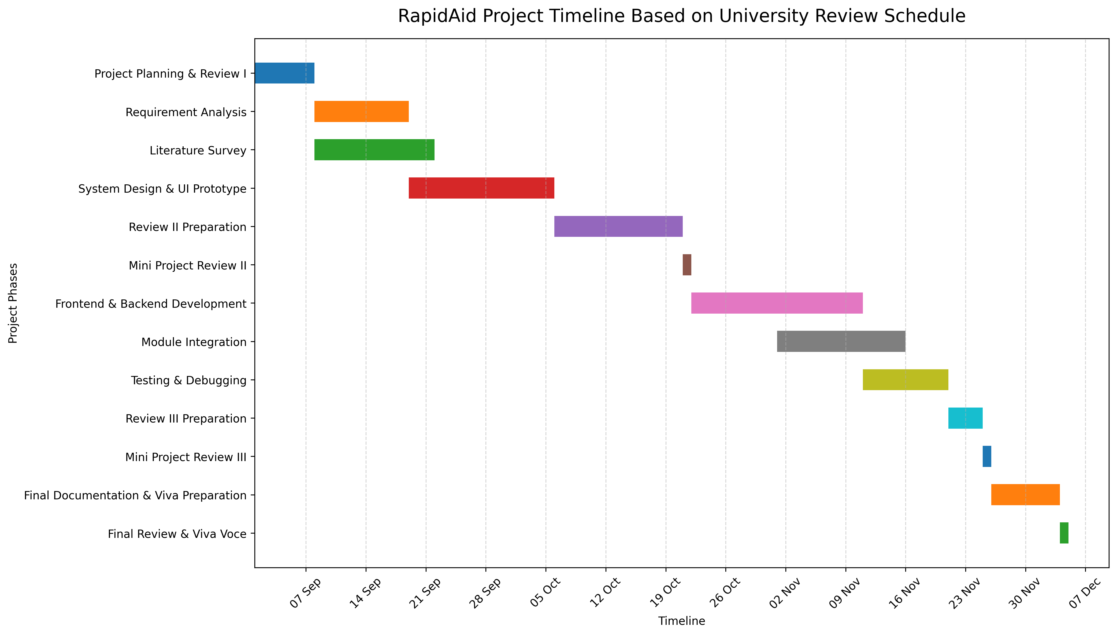
Timeline of the Project (Gantt Chart)

Slide 11
References (IEEE Paper format)
Birkun, A., & Ugur, S. (2018). Medical correctness and user-friendliness of available apps for cardiopulmonary resuscitation: Systematic search combined with guideline adherence and usability evaluation. JMIR mHealth and uHealth, 6(10).
Böttiger, B. W., et al. (2024). Enhancing the chain of survival: The role of smartphone applications in cardiopulmonary resuscitation. Journal article.
Metelmann, C., Metelmann, B., Schuffert, L., Hahnenkamp, K., Vollmer, M., & Brinkrolf, P. (2021). Smartphone apps to support laypersons in bystander CPR are of ambivalent benefit: A controlled trial using medical simulation. Scandinavian Journal of Trauma, Resuscitation and Emergency Medicine, 29, 76.
Márquez-Hernández, V. V., Gutiérrez-Puertas, L., Garrido-Molina, J. M., García-Viola, A., Granados-Gámez, G., & Aguilera-Manrique, G. (2020). Using a mobile phone application versus telephone assistance during cardiopulmonary resuscitation: A randomized comparative study. Journal of Emergency Nursing, 46(4), 460–467.
Murk, W., Goralnick, E., Brownstein, J. S., & Landman, A. B. (2023). Quality of layperson CPR instructions from artificial intelligence voice assistants. JAMA Network Open, 6(8).
Berglund, E., Claesson, A., Nordberg, P., et al. (2018). A smartphone application for dispatch of lay responders to out-of-hospital cardiac arrests. Resuscitation, 126, 160–165.
Caputo, M. L., et al. (2020). Enhancing citizen response to out-of-hospital cardiac arrest: A systematic review of mobile-phone systems to alert citizens as first responders. Resuscitation, 152, 16–25.
Böttiger, B. W., et al. (2020). Video-assisted cardiopulmonary resuscitation via smartphone improves quality of resuscitation: A randomised controlled simulation trial. Resuscitation.
Note: These references support the development of RapidAid, particularly its CPR guidance, voice assistance, smartphone support, AI-based guidance, and emergency-response features.

Slide 12


